Slide 1
23.02.2022 Pose Estimation
Alper Çetin
150190072

Slide 2
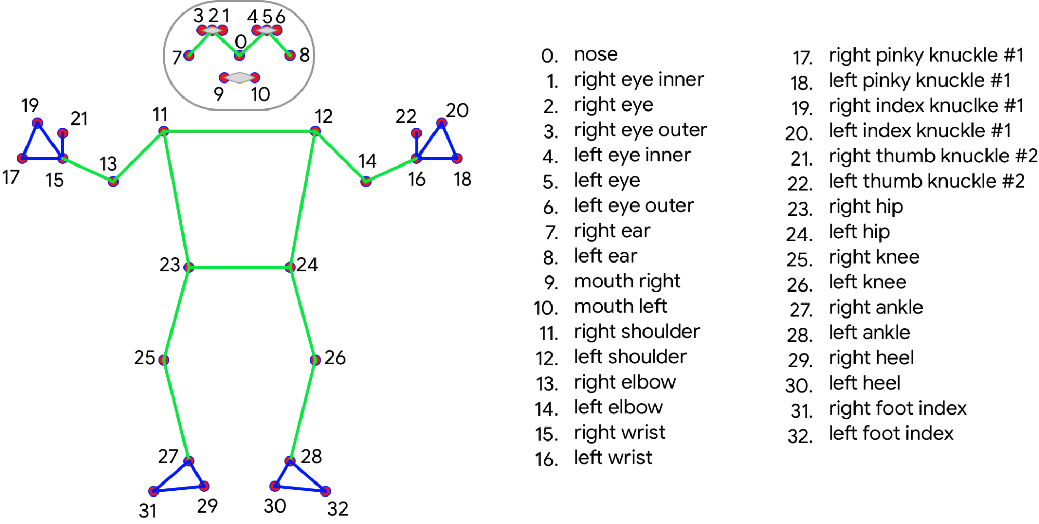
Drawing Landmarks on The Model

Slide 3
Curling A Joint
A degree between the 3 joints(Shoulder, Elbow and Wrist) must be bigger than 90 degree for a curling
Curling Counter is on the leftmost of the screen and incremented with the action of curling
It can also done via distances I prefer angles

Slide 4
Datasets
https://paperswithcode.com/datasets?task=3d-human-pose-estimation
Human3.6M: One of the largest dataset. (discussion, smoking, taking photo, talking on the phone, etc., )
LSP (Leeds Sports Pose): Widely used as the benchmark for pose estimation.
DensePose: Large scale ground truth dataset with image to surface correspondences.

Slide 5
What Is Used For AI Side With The Mediapipe
K-NN algorithm with BlasePose
BlasePose: Lightweight convolutional neural network architecture for human pose estimation

Slide 6
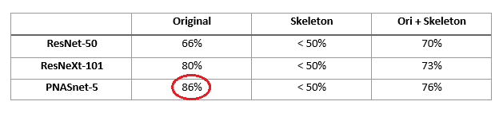
https://towardsdatascience.com/openpose-pnasnet-5-for-pose-classification-competition-fastai-dc35709158d0
3’rd in the competition

Slide 7
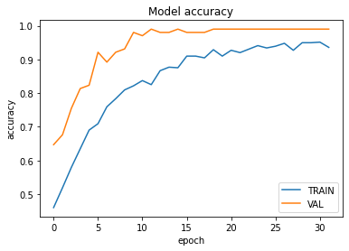
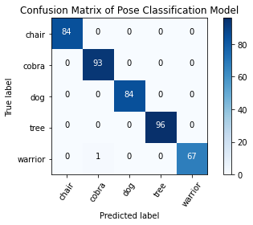
https://www.tensorflow.org/lite/tutorials/pose_classification
VAL = validation

